Slide 1
Calling All Doc Stars
@megansanicki, Open Source Strategist

Slide 2
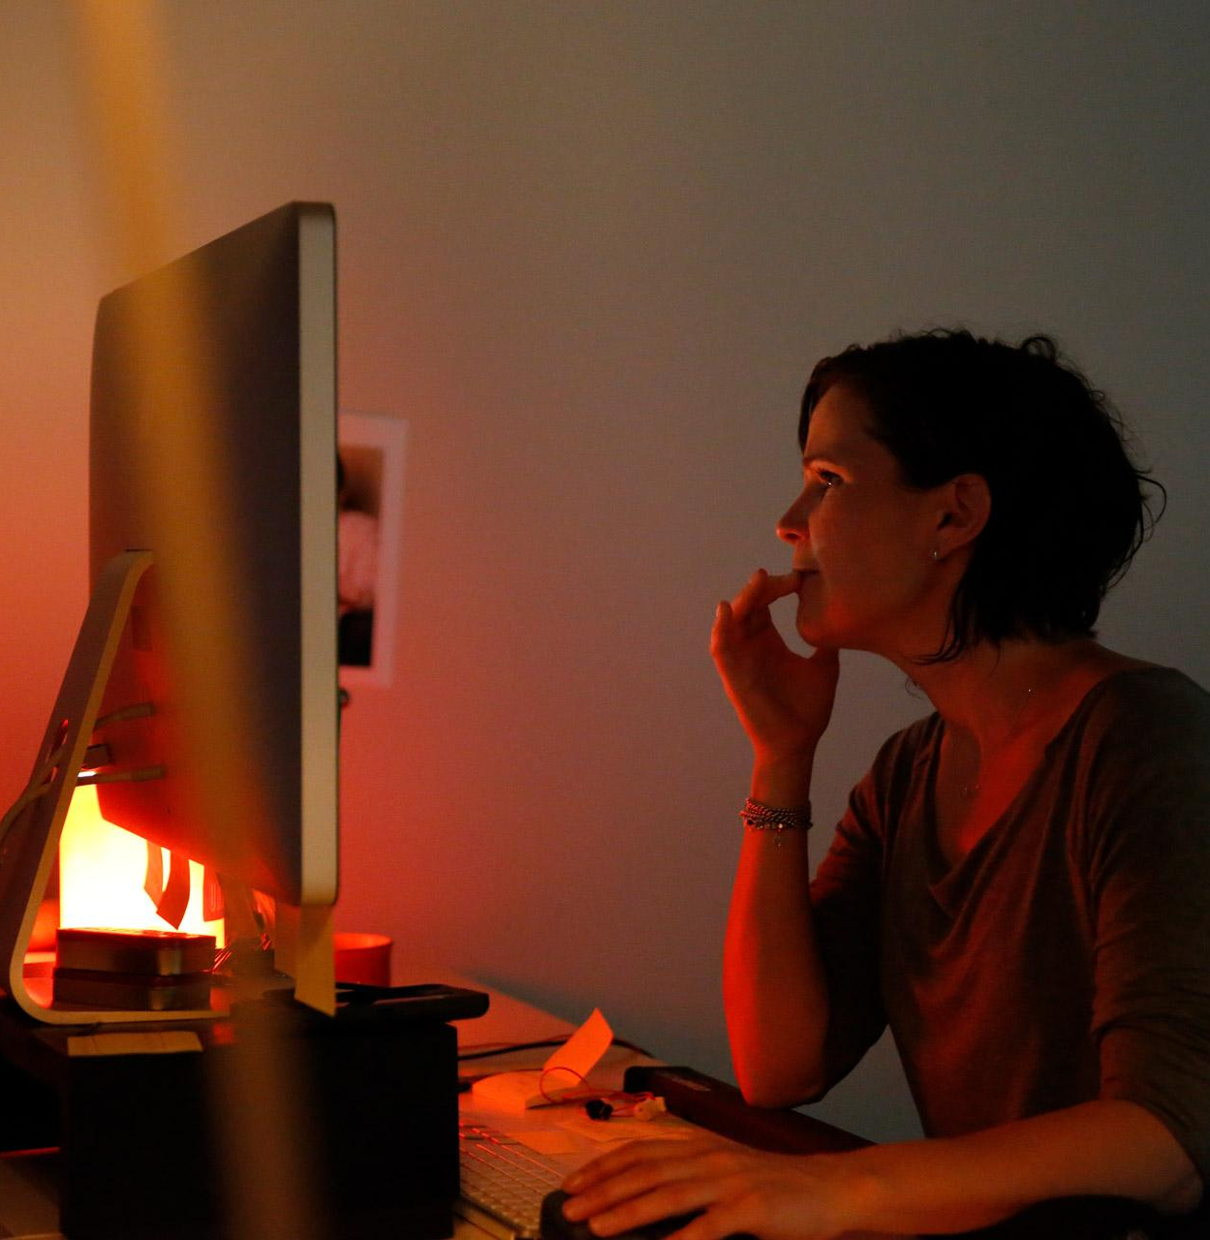
You made something special
Notes:
You worked hard to make great open source software. Of course you want others to use it. It’s rewarding to know that you made something - well - useful.

Slide 3
Documentation #1 adoption driver
Credit: Digital Ocean: https://www.digitalocean.com/currents/october-2018/
Notes:
One of your biggest levers for growing adoption is documentation
As digital ocean pointed out in their survey last year, 48% of the participants said a project needs good documentation before they can consider using it.
It’s the 2nd most important lever to adoption.

Slide 4
4%
Write documentation
Credit: Digital Ocean: https://www.digitalocean.com/currents/october-2018/
Notes:
But oddly, we spend all this time writing great code together, but only 4% actually write documentation.
Having such a small focus on it is a real fundamental blocker for much of open source.

Slide 5
Contribution blockers
Time
1
Support
2
Reward
3
Notes:
Google has over 2500 active projects and we want to make sure they are well used. Plus we care about this issue on behelf of the overall open source community
So we did a study to understand what is blocking all of us from writing great docs for our projects.
Here’s what we found:
Main blockers for contribution are time, support, and reward:
Contributors are short on time so they put it towards code mainly because it’s something they know how to contribute (it’s well documented, etc) and there is more reward and recognition for code contributions and much less for documentation. Plus, if their employers are paying for their contribution time, they feel that there is more value in contributing code rather than documentation.
The motivation and support are simply not there to support this kind of contribution.

Slide 6
Pro-tips
First contribution
1
Process
2
Recognition
3
Notes:
1. Encourage first contribution to be a docs contribution. Docs are a great way to make a first contribution, especially because community members new to the project and attempting to learn about it are ideally positioned to identify missing or inaccurate guidance/docs. And be sure to reach out to get others to contribute
2. Provide a clear process. Make it easy for people to know how to contribute to contribution.
It’s meta, but document the process to contribute to documentation.
3. Make it easy for people. Templates, templates, templates! :) Have templates for docs you want to see exist, or even just jot down quick outlines or links to docs you admire. People work better when there's something already on the page!
3. Reward: I think we need something here about recognizing and rewarding docs contributions. Ideas: Include doc updates in your release notes (treat documentation like another feature). Public, on-list thanks and acknowledgements. Doc contributions as a path to committer status.

Slide 7
Notes:
We know it’s not an easy change to make - especially making the time and resources available. So Google is putting its money where its mouth is the newly launched Season of Docs. it builds on the success of our Summer of Code program where we match developers with open source projects.
With Season of docs we are pairing tech writers with 50 open source projects and paying them.

Slide 8
50 Projects
AboutCode
Apache Airflow
Apache Cassandra
Arduino
ARK Ecosystem
BRL-CAD
CERN-HSF
Drupal
DVC.org
Ensemble
GDevelop
GenPipes
GNU Mailman
Gstreamer editing services
HPX
Hydra Ecosystem Documentation
INCF
Kaleidoscope
Kolibri
Libreoffice
LLVM Compiler Infrastructure
Mattermost
MDAnalysis
NRNB
NumPy
Open Collective
Open Data Kit
Open Food Facts
Open Source Geospatial Foundation
Open 3D
OpenELIS Global
OpenMRS.org
OpenSCAD
Oppia
OWASP Foundation
Plone
PostgreSQL
Qubes OS
RoboComp
Rocket.Chat
SciPy
Shogun.ML
Software Heritage
SymPy
The FreeBSD Project
The Wikimedia Foundation
Tor Project
VideoLAN
Whonix
Zulip Open Source Team Chat

Slide 9
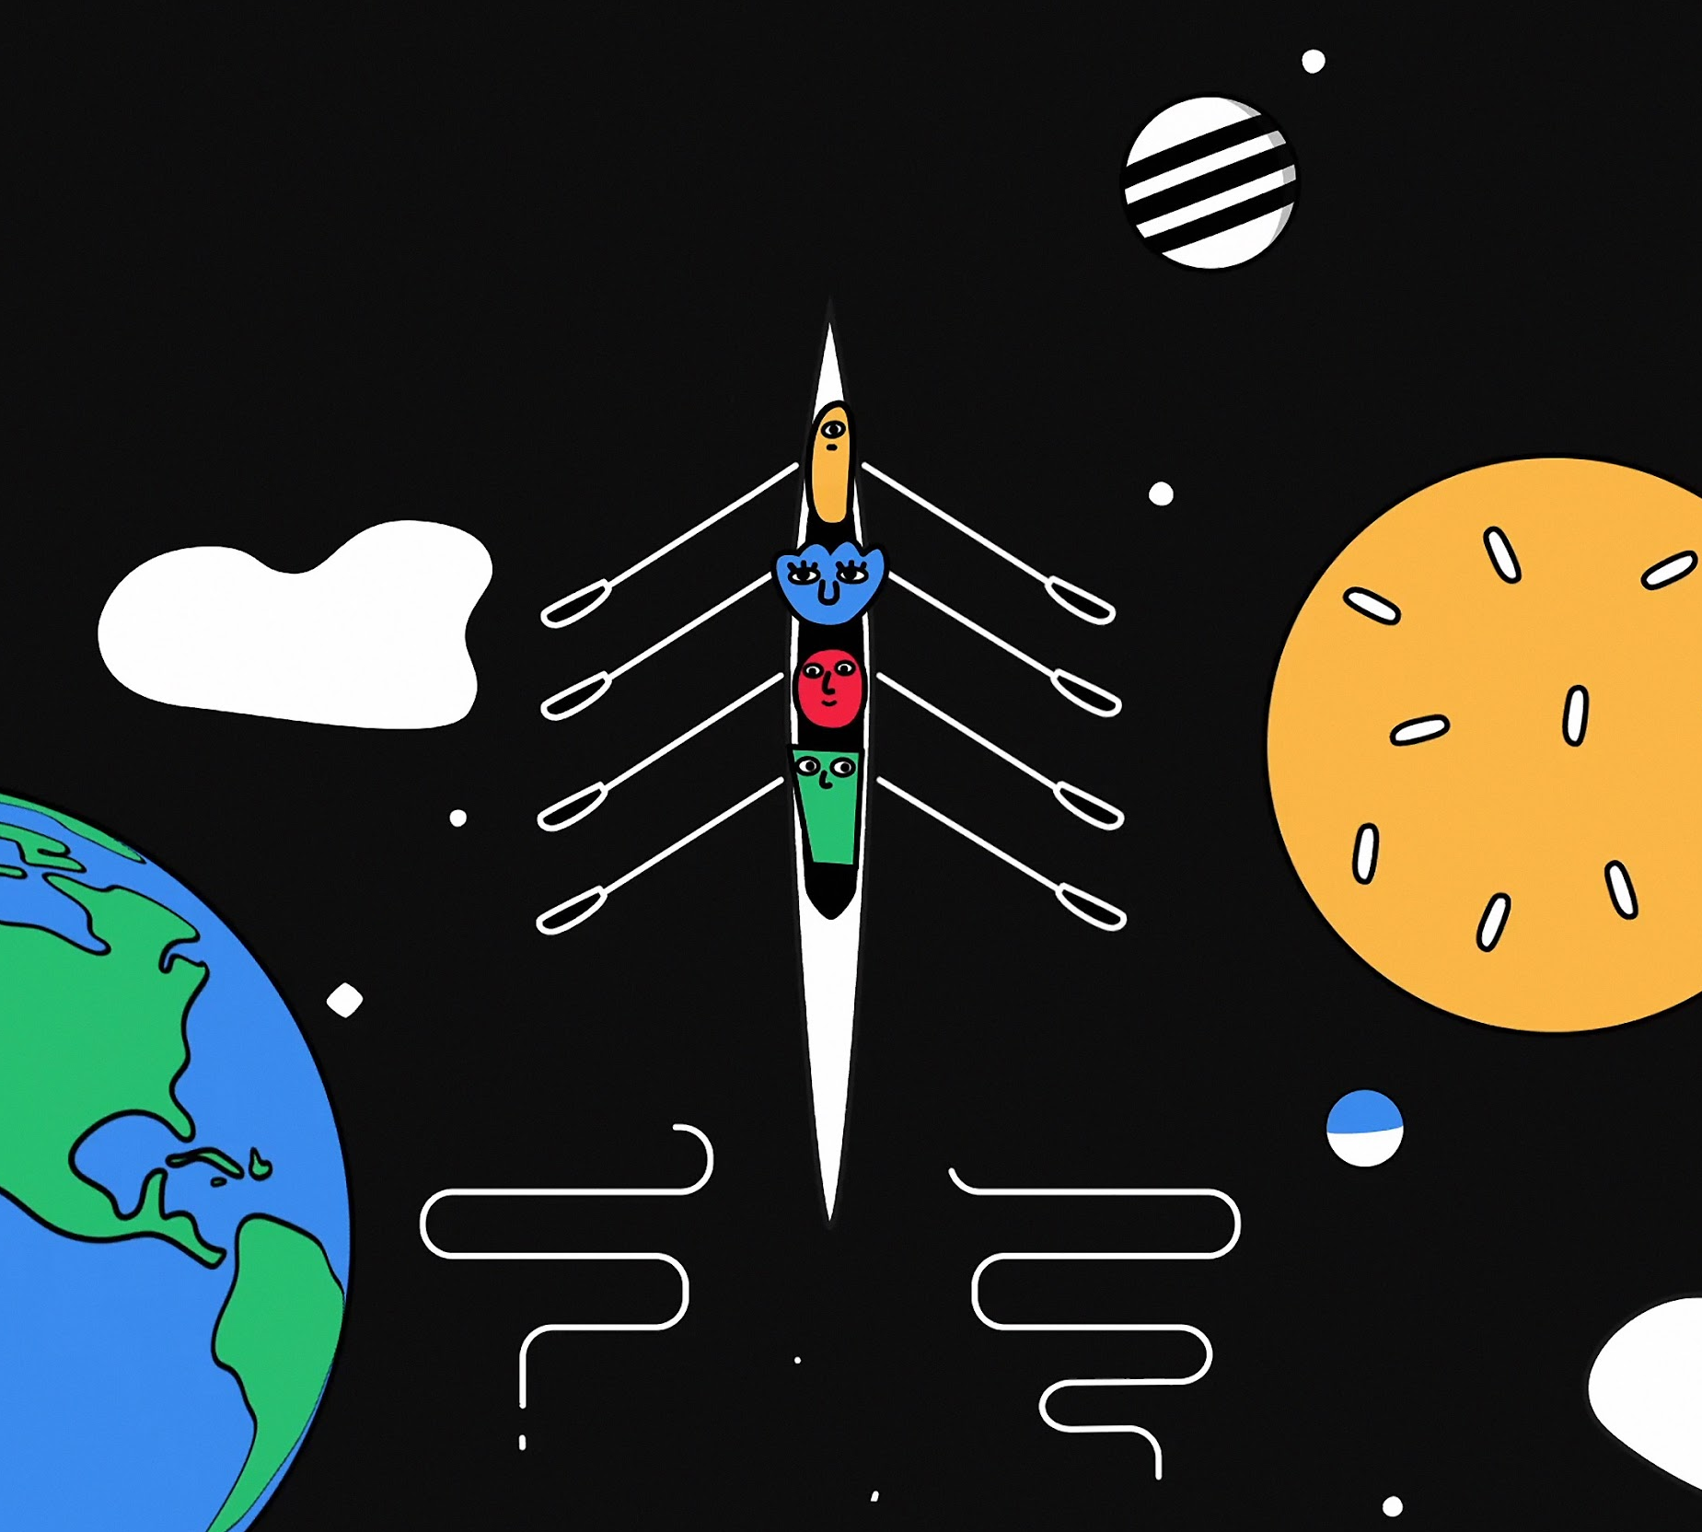
Learn more
at the
Google booth
Notes:
Come by our booth to learn more about this program
And you can thank a contributor of any kind today by recognizing them on our gratitude wall

